Slide 1
DESIGN AND ANALYSIS OF ALGORITHMS
Dr Tathagata Ray, BITS- Pilani

Slide 2
Topological sorting

Slide 3
Topological sort
We have a set of tasks and a set of dependencies (precedence constraints) of form “task A must be done before task B”
Topological sort: An ordering of the tasks that conforms with the given dependencies
Goal: Find a topological sort of the tasks or decide that there is no such ordering

Slide 4
Examples
Scheduling: When scheduling task graphs in distributed systems, usually we first need to sort the tasks topologically and then assign them to resources (the most efficient scheduling is an NP-complete problem)
Or during compilation to order modules/libraries

Slide 5
Topological sort more formally
In a directed graph G = (V, E) vertices V represent tasks, and each edge (u, v)∊E means that task u must be done before task v
An ordering of vertices 1, ..., |V| such that for every edge (u, v), u appears before v in the ordering
Such an ordering is called a topological sort of G
Note: there can be multiple topological sorts of G

Slide 6
Algorithm for TS
TOPOLOGICAL-SORT(G):
  call DFS(G) to compute finishing times f[v] for each vertex v
  as each vertex is finished, insert it onto the front of a linked list
  return the linked list of vertices
Note that the result is just a list of vertices in order of decreasing finish times f[]

Slide 7
Edge classification by DFS
Edge (u,v) of G is classified as a:
(1) Tree edge iff u discovers v during the DFS: P[v] = u
If (u,v) is NOT a tree edge then it is a:
(2) Forward edge iff u is an ancestor of v in the DFS tree
(3) Back edge iff u is a descendant of v in the DFS tree
(4) Cross edge iff u is neither an ancestor nor a descendant of v

Slide 8
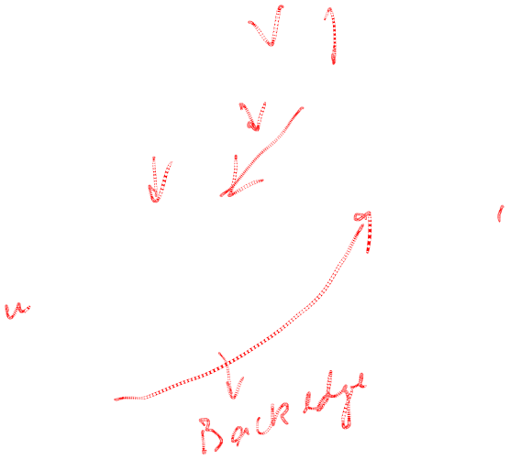


Edge classification by DFS
Tree edges
Forward edges
Back edges
Cross edges
a
b
c
c
The edge classification depends on the particular DFS tree!

Slide 9
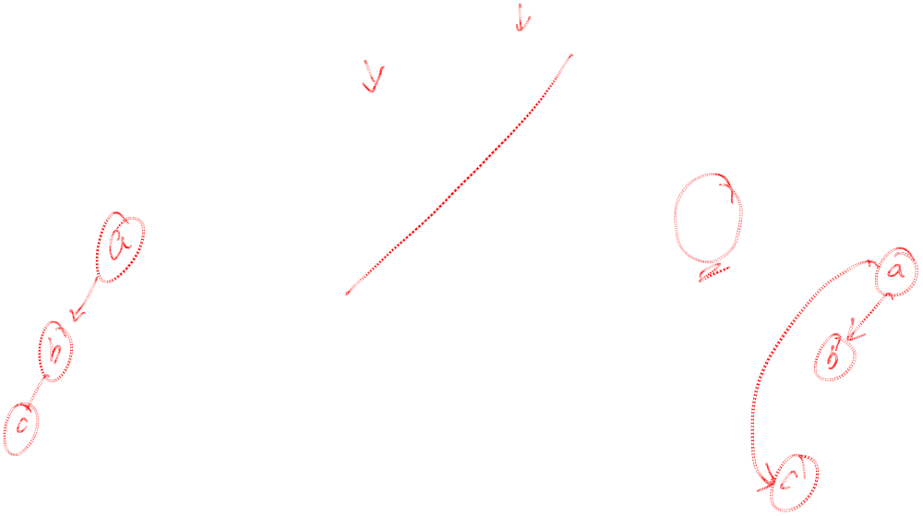

Edge classification by DFS
Tree edges
Forward edges
Back edges
Cross edges
Both are valid
a
a
b
b
c
c
The edge classification depends on the particular DFS tree!

Slide 10
Back to topological sort
TOPOLOGICAL-SORT(G):
  call DFS(G) to compute finishing times f[v] for each vertex v
  as each vertex is finished, insert it onto the front of a linked list
  return the linked list of vertices

Slide 11
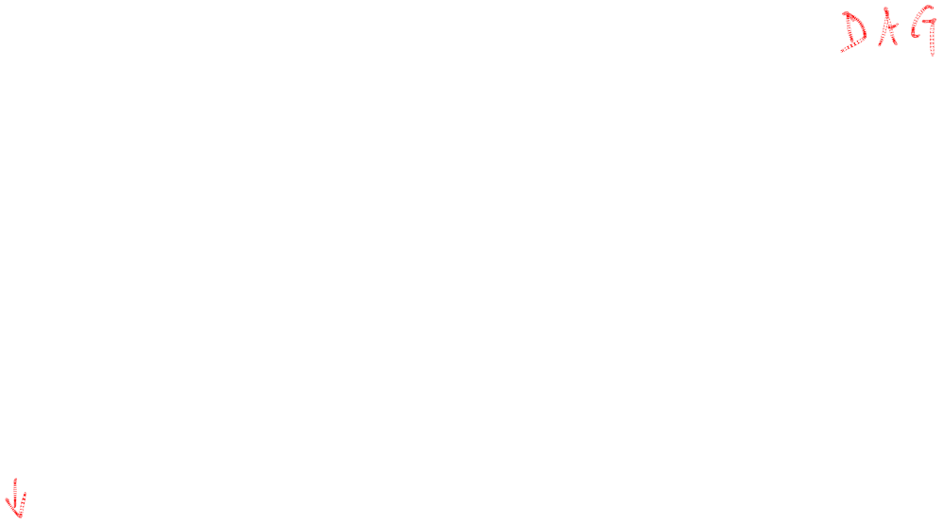

Topological sort
Call DFS(G) to compute the finishing times f[v]
Time = 1
Time = 2
d = ∞
f = ∞
Let’s say we start the DFS from the vertex c
a
d = ∞
f = ∞
Next we discover the vertex d
d = ∞
f = ∞
d = 1
f = ∞
b
c
c
d = ∞
f = ∞
d = ∞
f = ∞
d
e
d = ∞
f = ∞
f

Slide 12


Topological sort
Call DFS(G) to compute the finishing times f[v]
Time = 2
Time = 3
d = ∞
f = ∞
Let’s say we start the DFS from the vertex c
a
d = 1
f = ∞
Next we discover the vertex d
d = ∞
f = ∞
b
c
c
d = ∞
f = ∞
d = ∞
f = ∞
d = 2
f = ∞
d
d
e
d = ∞
f = ∞
f

Slide 13




Topological sort
Call DFS(G) to compute the finishing times f[v]
Time = 3
Time = 4
  as each vertex is finished, insert it onto the front of a linked list
d = ∞
f = ∞
Let’s say we start the DFS from the vertex c
a
d = 1
f = ∞
Next we discover the vertex d
d = ∞
f = ∞
b
c
c
Next we discover the vertex f
d = 2
f = ∞
d = ∞
f = ∞
f is done, move back to d
d
d
e
d = 3
f = ∞
d = 3
f = 4
f
f
f

Slide 14

Topological sort
Call DFS(G) to compute the finishing times f[v]
Time = 4
Time = 5
d = ∞
f = ∞
Let’s say we start the DFS from the vertex c
a
d = 1
f = ∞
Next we discover the vertex d
d = ∞
f = ∞
b
c
c
Next we discover the vertex f
d = 2
f = 5
d = ∞
f = ∞
f is done, move back to d
d
d
e
d is done, move back to c
d = 3
f = 4
f
f
d
f

Slide 15

Topological sort
Call DFS(G) to compute the finishing times f[v]
Time = 5
Time = 6
d = ∞
f = ∞
Let’s say we start the DFS from the vertex c
a
d = 1
f = ∞
Next we discover the vertex d
d = ∞
f = ∞
b
c
c
Next we discover the vertex f
d = 2
f = 5
d = ∞
f = ∞
f is done, move back to d
d
d
e
d is done, move back to c
d = 3
f = 4
Next we discover the vertex e
f
f
d
f

Slide 16
Topological sort
Call DFS(G) to compute the finishing times f[v]
Time = 6
Time = 7
d = ∞
f = ∞
Let’s say we start the DFS from the vertex c
a
d = 1
f = ∞
Next we discover the vertex d
d = ∞
f = ∞
b
c
Next we discover the vertex f
Both edges from e are cross edges
d = 2
f = 5
d = 6
f = ∞
f is done, move back to d
d
d
e
e
d is done, move back to c
d = 3
f = 4
Next we discover the vertex e
f
f
e is done, move back to c
e
d
f

Slide 17
Topological sort
Call DFS(G) to compute the finishing times f[v]
Time = 7
Time = 8
d = ∞
f = ∞
Let’s say we start the DFS from the vertex c
a
Just a note: If there was (c,f) edge in the graph, it would be classified as a forward edge
(in this particular DFS run)
d = 1
f = ∞
Next we discover the vertex d
d = ∞
f = ∞
b
c
Next we discover the vertex f
d = 2
f = 5
d = 6
f = 7
f is done, move back to d
d
d
e
e
d is done, move back to c
d = 3
f = 4
Next we discover the vertex e
f
f
e is done, move back to c
c
e
d
f
c is done as well

Slide 18

Topological sort
Call DFS(G) to compute the finishing times f[v]
Time = 9
Time = 10
d = ∞
f = ∞
Let’s now call DFS visit from the vertex a
d = 9
f = ∞
a
a
d = 1
f = 8
Next we discover the vertex c,
but c was already processed => (a,c) is a cross edge
d = ∞
f = ∞
b
c
d = 2
f = 5
d = 6
f = 7
Next we discover the vertex b
d
d
e
e
d = 3
f = 4
f
f
c
e
d
f

Slide 19
Topological sort
Call DFS(G) to compute the finishing times f[v]
Time = 10
Time = 11
d = 9
f = ∞
Let’s now call DFS visit from the vertex a
a
a
d = 1
f = 8
Next we discover the vertex c,
but c was already processed => (a,c) is a cross edge
d = 10
f = ∞
d = 10
f = 11
b
b
c
d = 2
f = 5
d = 6
f = 7
Next we discover the vertex b
d
d
e
e
b is done as (b,d) is a cross edge => now move back to c
d = 3
f = 4
f
f
b
c
e
d
f

Slide 20
Topological sort
Call DFS(G) to compute the finishing times f[v]
Time = 11
Time = 12
d = 9
f = ∞
Let’s now call DFS visit from the vertex a
a
a
d = 1
f = 8
Next we discover the vertex c,
but c was already processed => (a,c) is a cross edge
d = 10
f = 11
b
b
c
d = 2
f = 5
d = 6
f = 7
Next we discover the vertex b
d
d
e
e
b is done as (b,d) is a cross edge => now move back to c
d = 3
f = 4
f
f
a is done as well
b
c
e
d
f

Slide 21
Topological sort
Call DFS(G) to compute the finishing times f[v]
Time = 11
Time = 13
d = 9
f = 12
Let’s now call DFS visit from the vertex a
  WE HAVE THE RESULT!
  return the linked list of vertices
a
a
d = 1
f = 8
Next we discover the vertex c,
but c was already processed => (a,c) is a cross edge
d = 10
f = 11
b
b
c
d = 2
f = 5
d = 6
f = 7
Next we discover the vertex b
d
d
e
e
b is done as (b,d) is a cross edge => now move back to c
d = 3
f = 4
f
f
a is done as well
a
b
c
e
d
f

Slide 22
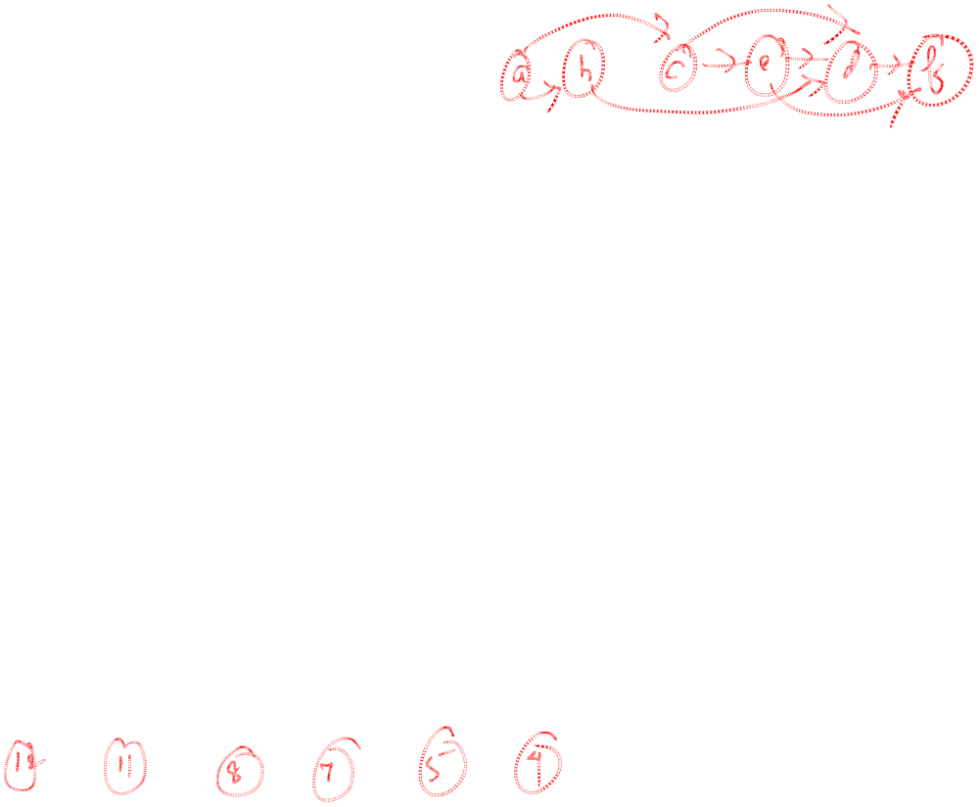
Topological sort
Time = 11
Time = 13
  The linked list is sorted in decreasing order of finishing times f[]
d = 9
f = 12
a
a
d = 10
f = 11
d = 1
f = 8
b
  Try yourself with different vertex order for DFS visit
b
c
d = 2
f = 5
d = 6
f = 7
d
d
e
e
  Note: If you redraw the graph so that all vertices are in a line ordered by a valid topological sort, then all edges point „from left to right“
d = 3
f = 4
f
f
a
b
c
e
d
f

Slide 23
Time complexity of TS(G)
Running time of topological sort:
Θ(n + m)
where n=|V| and m=|E|
Why? Depth first search takes Θ(n + m) time in the worst case, and inserting into the front of a linked list takes Θ(1) time

Slide 24
Proof of correctness
Theorem: TOPOLOGICAL-SORT(G) produces a topological sort of a DAG G
The TOPOLOGICAL-SORT(G) algorithm does a DFS on the DAG G, and it lists the nodes of G in order of decreasing finish times f[]
We must show that this list satisfies the topological sort property, namely, that for every edge (u,v) of G, u appears before v in the list
Claim: For every edge (u,v) of G: f[v] < f[u] in DFS

Slide 25
Proof of correctness
“For every edge (u,v) of G, f[v] < f[u] in this DFS”
The DFS classifies (u,v) as a tree edge, a forward edge or a cross-edge (it cannot be a back-edge since G has no cycles):
  If (u,v) is a tree or a forward edge ⇒ v is a descendant of u ⇒ f[v] < f[u]
  If (u,v) is a cross-edge

Slide 26
Proof of correctness
“For every edge (u,v) of G: f[v] < f[u] in this DFS”
  If (u,v) is a cross-edge:
as (u,v) is a cross-edge, by definition, neither u is a descendant of v nor v is a descendant of u:
  d[u] < f[u] < d[v] < f[v]
  or
  d[v] < f[v] < d[u] < f[u]
Q.E.D. of Claim
since (u,v) is an edge, v is surely discovered before u's exploration completes
f[v] < f[u]

Slide 27
Proof of correctness
TOPOLOGICAL-SORT(G) lists the nodes of G from highest to lowest finishing times
By the Claim, for every edge (u,v) of G:
f[v] < f[u]
⇒ u will be before v in the algorithm's list
Q.E.D of Theorem

Slide 28
Thank you

